Slide 1
Project: Time Stone
Trading with keras
Presented by 김경한
2020년 3월 9일
https://github.com/kyunghankim/TIL

Slide 2
Index
01. What is RNN
01-1. RNN and Long-Term Dependencies
01-2. LSTM
02. Prediction using LSTM
02-1. Get data from yahoofinance
02-2. Using keras
02-3. Prediction
03. Trading Outcome
03-1. Profitday ratio
03-2. Expected P/L
03-3. Further reading & Future plan

Slide 3
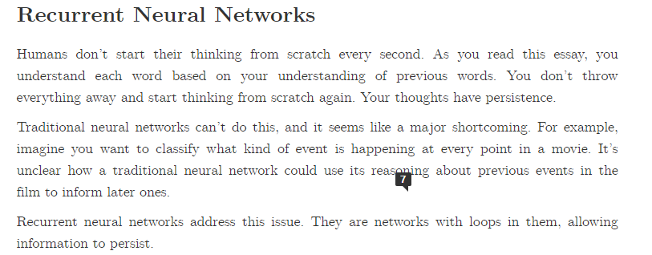
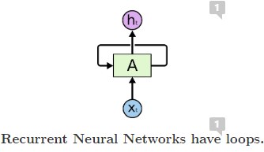
What is RNN?
01-1. RNN and Long-Term Dependencies
http://colah.github.io/posts/2015-08-Understanding-LSTMs/

Slide 4
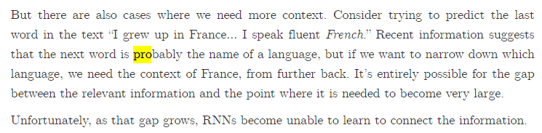
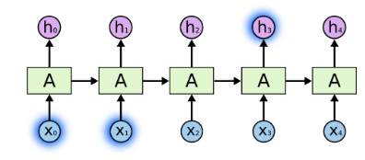
Long-Term Dependencies
01-2. Long-Short Term Model(LSTM)
http://colah.github.io/posts/2015-08-Understanding-LSTMs/

Slide 5
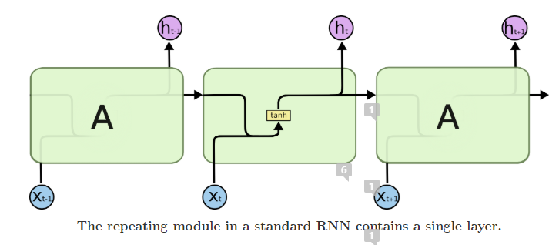
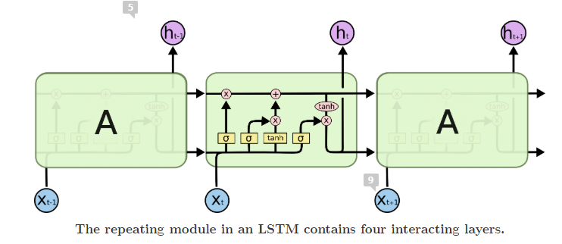
LSTM
http://colah.github.io/posts/2015-08-Understanding-LSTMs/

Slide 6
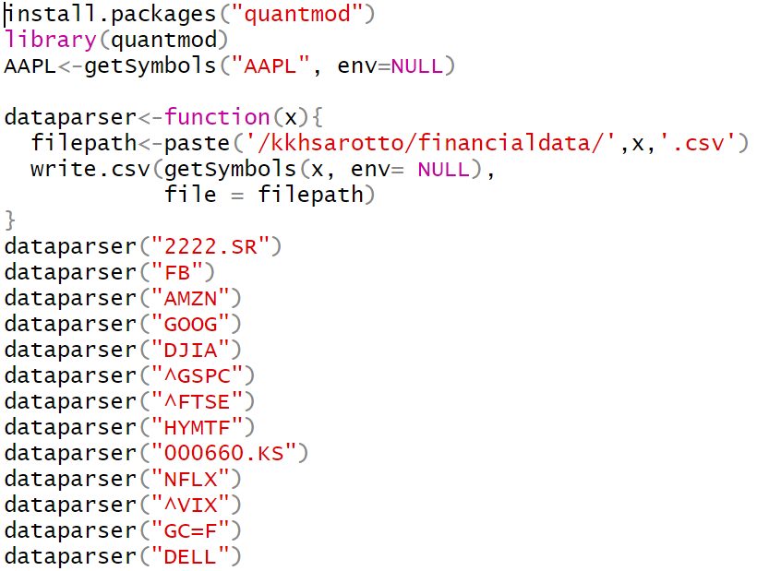
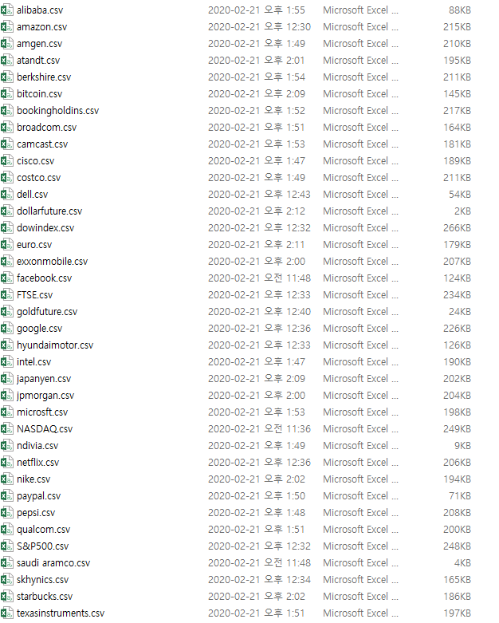
02. Prediction using LSTM
02-1. Get data from yahoofinance using R
https://github.com/kyunghankim/TIL

Slide 7
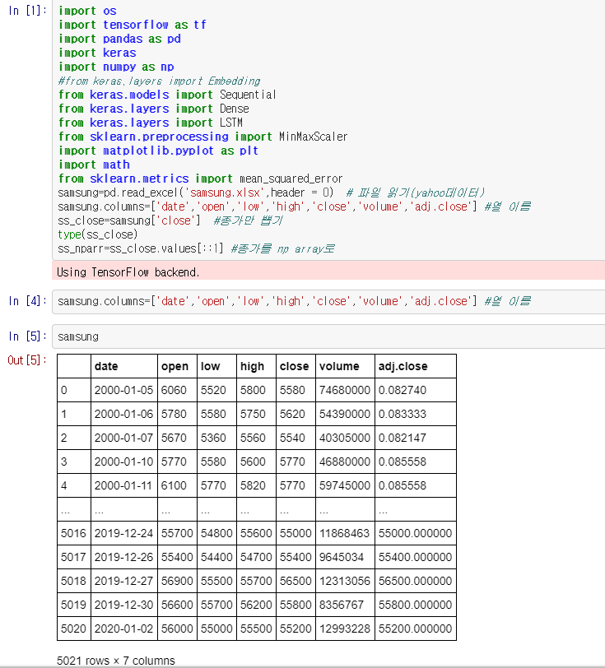
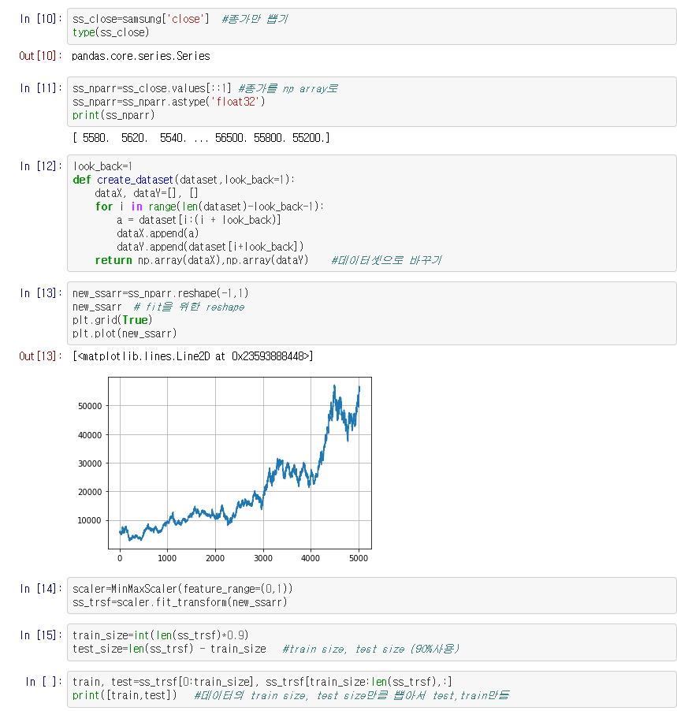
02. Prediction using LSTM
02-2. Using keras on jupyter notebook
https://github.com/kyunghankim/TIL

Slide 8
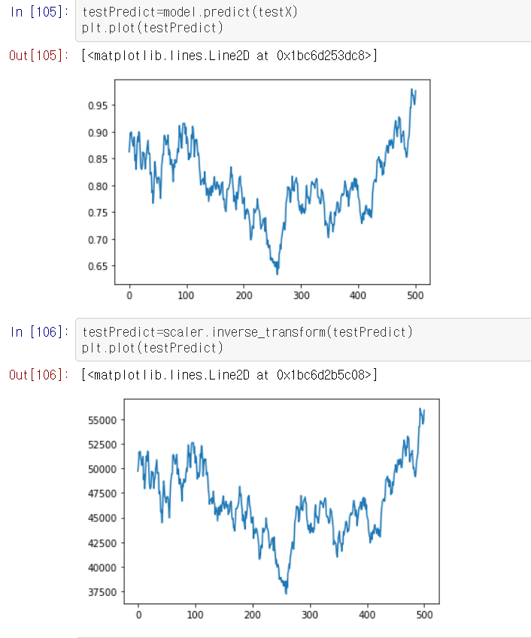
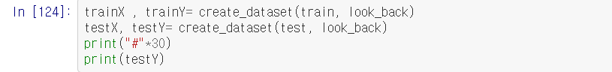
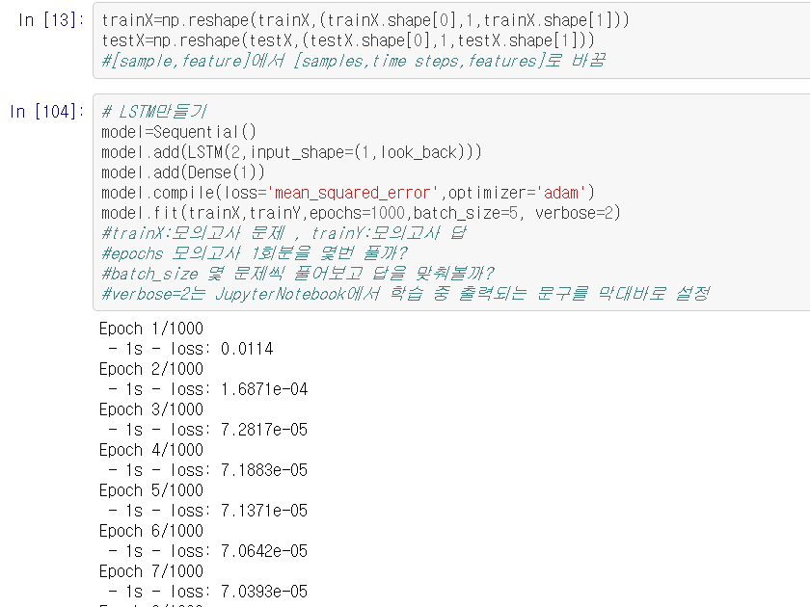
Using Keras & Prediction
02-2. Using keras on jupyter notebook
https://github.com/kyunghankim/TIL

Slide 9
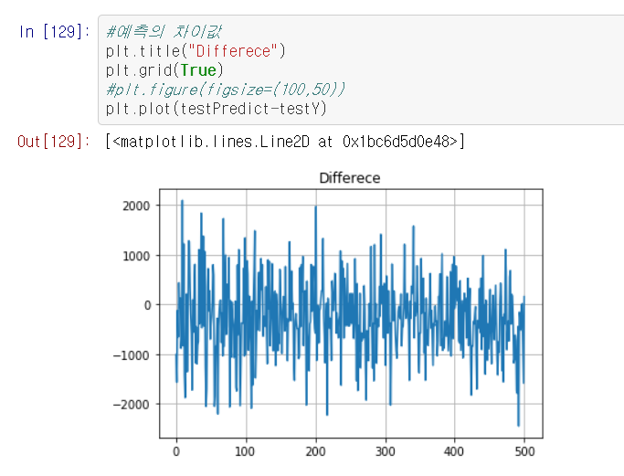
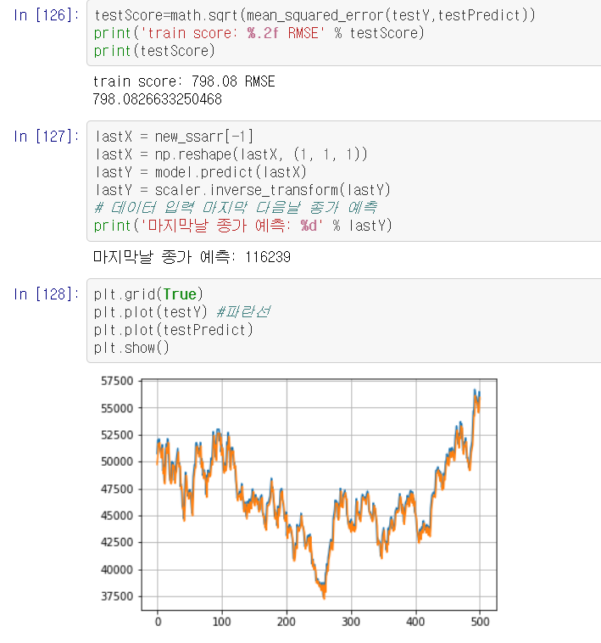
Using Keras & Prediction
02-2. Using keras on jupyter notebook
https://github.com/kyunghankim/TIL

Slide 10
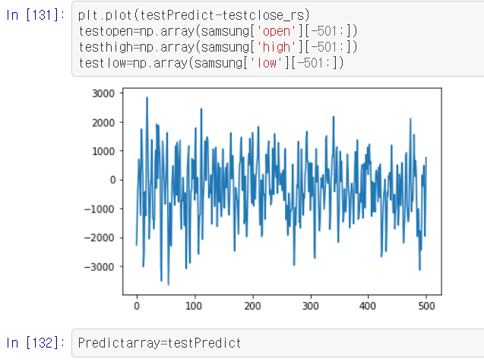
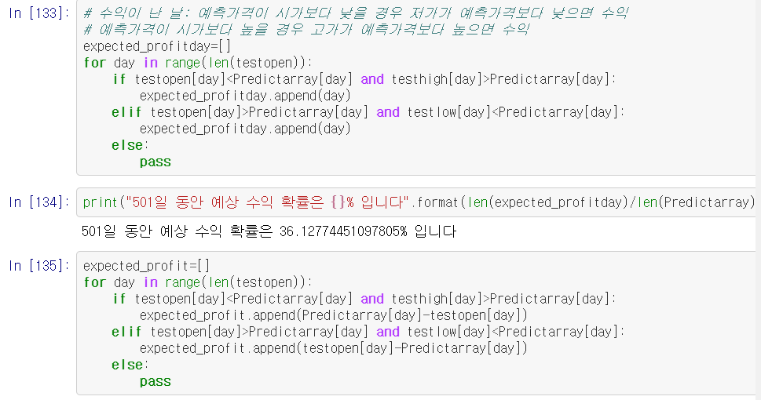
Trading Outcome
03-01 Profitday Ratio
https://github.com/kyunghankim/TIL

Slide 11
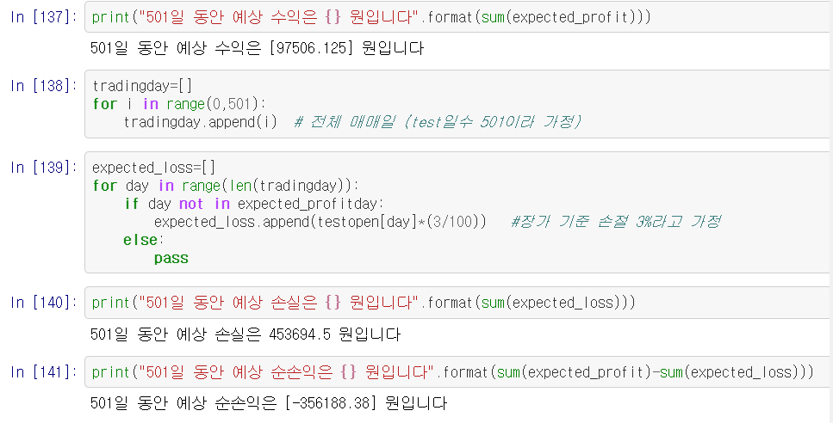
Trading Outcome
03-01 Profitday Ratio
https://github.com/kyunghankim/TIL

Slide 12
Trading Outcome
03-02. Expected P/L
https://github.com/kyunghankim/TIL

Slide 13
Trading Outcome
03-03. Further reading & Future plan
*RNN,LSTM:
http://colah.github.io/posts/2015-08-Understanding-LSTMs/
*한글정리 블로그:
:http://docs.likejazz.com/lstm/
*활성화함수 블로그:
https://m.blog.naver.com/wideeyed/221017173808
About
RNN / LSTM
And Activate Function
*RNN의 효율성,활용:
http://karpathy.github.io/2015/05/21/rnn-effectiveness/
The Effectiveness of RNN
Reading about LSTM
*Support Vector Machine:
https://ko.wikipedia.org/wiki/%EC%84%9C%ED%8F%AC%ED%8A%B8_%EB%B2%A1%ED%84%B0_%EB%A8%B8%EC%8B%A0
*kNN,SVM주식투자:
https://stock79.tistory.com/217?category=596062
Future Plan:
https://github.com/kyunghankim/TIL

Slide 14
Q&N

Slide 15
Thanks

